Slide 1

State of the Feather
Sam Ruby, President

Slide 2


Who am I?
Sam Ruby
ASF President
Assistant Secretary
VP, Whimsy

Slide 3

Yes, the last one is a real title

Slide 4
Some statistics
5822 Committers
684 Members
181 PMCs
59 Podlings
96 Groups

Slide 5
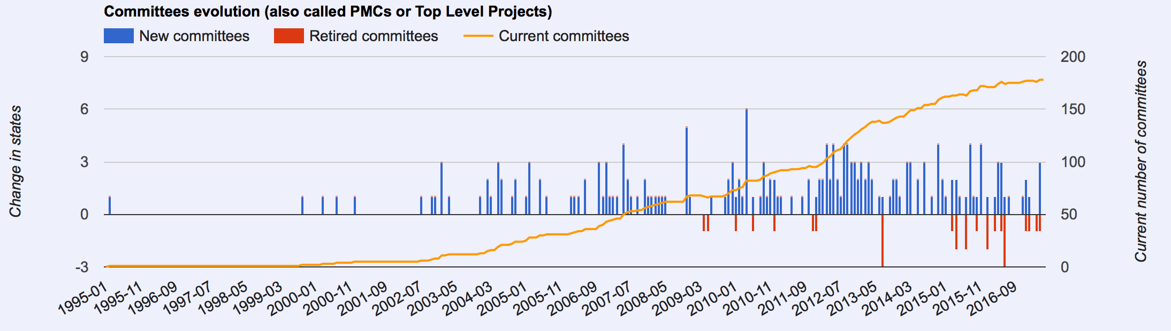
A pretty graph

Slide 6
Agenda
How we got here
What we believe in
How we are different

Slide 7
About this talk
This isn’t another “the ASF is great” presentation where I will talk about how we do things differently/better than others.
Instead, this is a talk where I identify what works and where there is more work that needs to be done.

Slide 8
About this talk
This isn’t another “the ASF is great” presentation where I will talk about how we do things differently/better than others.
Instead, this is a talk where I identify what works and where there is more work that needs to be done.
… In fact, I’m going to do the talk backwards.

Slide 9
TL;DR
We’ve been around for 18 years.
We’re continuing to grow by every measure.

Slide 10
More importantly…
We expect to continue to be around.
We expect to continue to grow.

Slide 11
More importantly…
We expect to continue to be around.
We expect to continue to grow.
  Perhaps even a bit too fast.

Slide 12
Our secret?
Diversity
Independence
Openness

Slide 13
Excerpts from Incubation Exit Criteria
Demonstrate an active and diverse development community
There are at least 3 legally independent committers and there is no single company or entity that is vital to the success of the project
Developed and executed in public

Slide 14
And we mean it

Slide 15
And we mean it
No one committer has any more say than any other committer as to what code is accepted.

Slide 16
And we mean it
No one PMC member has any more say than any other PMC member as to when a release is made.

Slide 17
And we mean it
All ASF member votes have equal weight.

Slide 18
And we mean it
No Director has any more ability to set policy than any other Director.

Slide 19
Concrete Example

Slide 20
Background
I was the first non-Sun release manager for Tomcat.
I’ve been here for 17 years.
I’ve been a Director for 13 years.
I’m an ASF Member.
I currently hold the title of ASF President.

Slide 21
Current Status
No longer active on that particular project.
I am fully confident that I would be promptly and enthusiastically welcomed back should I decide to once again become active.

Slide 22
Current Status
No longer active on that particular project.
I am fully confident that I would be promptly and enthusiastically welcomed back should I decide to once again become active.
… but only as an equal.

Slide 23
I’m not saying it is easy…
We encounter BDFL wannabies in Incubation.
We have PMCs wanting to release without votes.
We have over-exuberant companies wanting to create press releases talking about their employee’s ”leadership” when they become PMC chairs.
We have grey beads asserting that new ideas aren’t the way things were done “back in the day”.

Slide 24
I’m not saying it is easy…
All contributors are important.
No contributor is irreplaceable.

Slide 26
I’m not saying it is easy…
We have a business friendly license.
We welcome and appreciate donations from generous sponsors.
We have a strict vendor-neutral policy.

Slide 27
I’m not saying it is easy…
100 people planning 100 small conferences may work, but having 20 people planning one big conference doesn’t work as well.
Letting a PMC have their own brand policy may affect other PMCs ability to enforce their mark.
Having committers work on what they want to may work, but having sysadmins choosing only the fun tickets doesn’t.

Slide 28
I’m not saying it is easy…
Sometimes the solution is to turn non-fun or time critical tasks into paid positions.
While we have substantial financial reserves, we are currently running an unsustainable deficit.
Expanding the pool of sponsors may run up to the question as to the “ROI” of the investment.

Slide 29
I’m not saying it is easy…
But things that are worth doing aren’t always easy.

Slide 30
I’m not saying it is easy…
But things that are worth doing aren’t always easy.
And supporting the communities that have made the ASF a home is definitely worth doing.

Slide 31
Recapping our core values
Diversity
Independence
Openness

Slide 32
Returning to our core values
Diversity
Independence
Openness
… hopefully you now have more of an appreciation what we mean by these and why they are important to our longevity

Slide 33
Returning to our core values
Diversity
Independence
Openness
… hopefully you now have more of an appreciation what we mean by these and why they are important to our longevity
… even when we have rare exceptions

Slide 34
Returning to the statistics
5822 Committers
684 Members
181 PMCs
59 Podlings
96 Groups
... hopefully you now have more context for these numbers

Slide 35
And again with the pretty graph

Slide 36
And finally…
An appreciation of what the following enable:
Sponsors
Donors

Slide 37


Slide 38
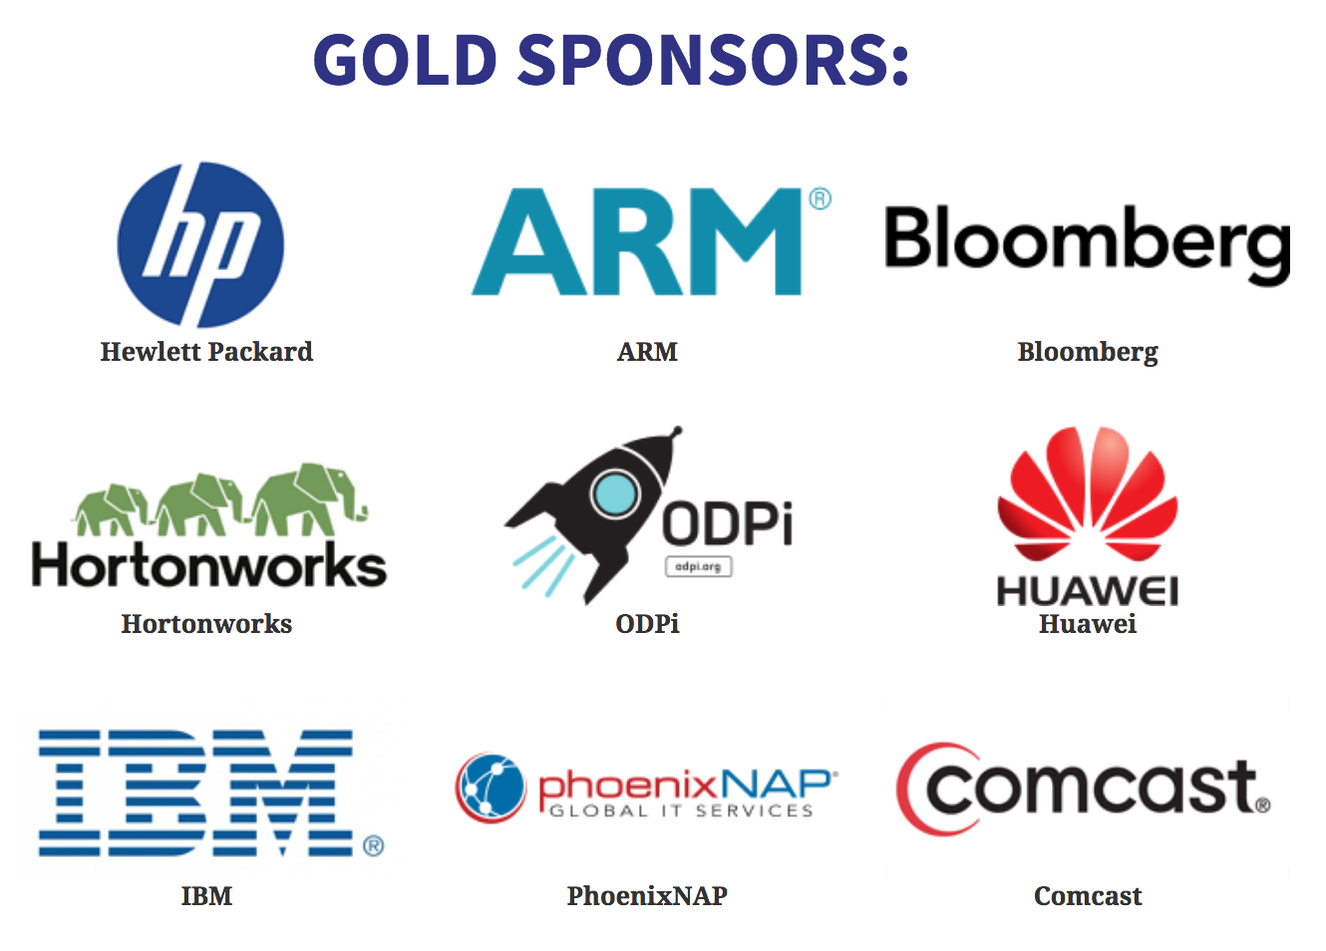

Slide 39
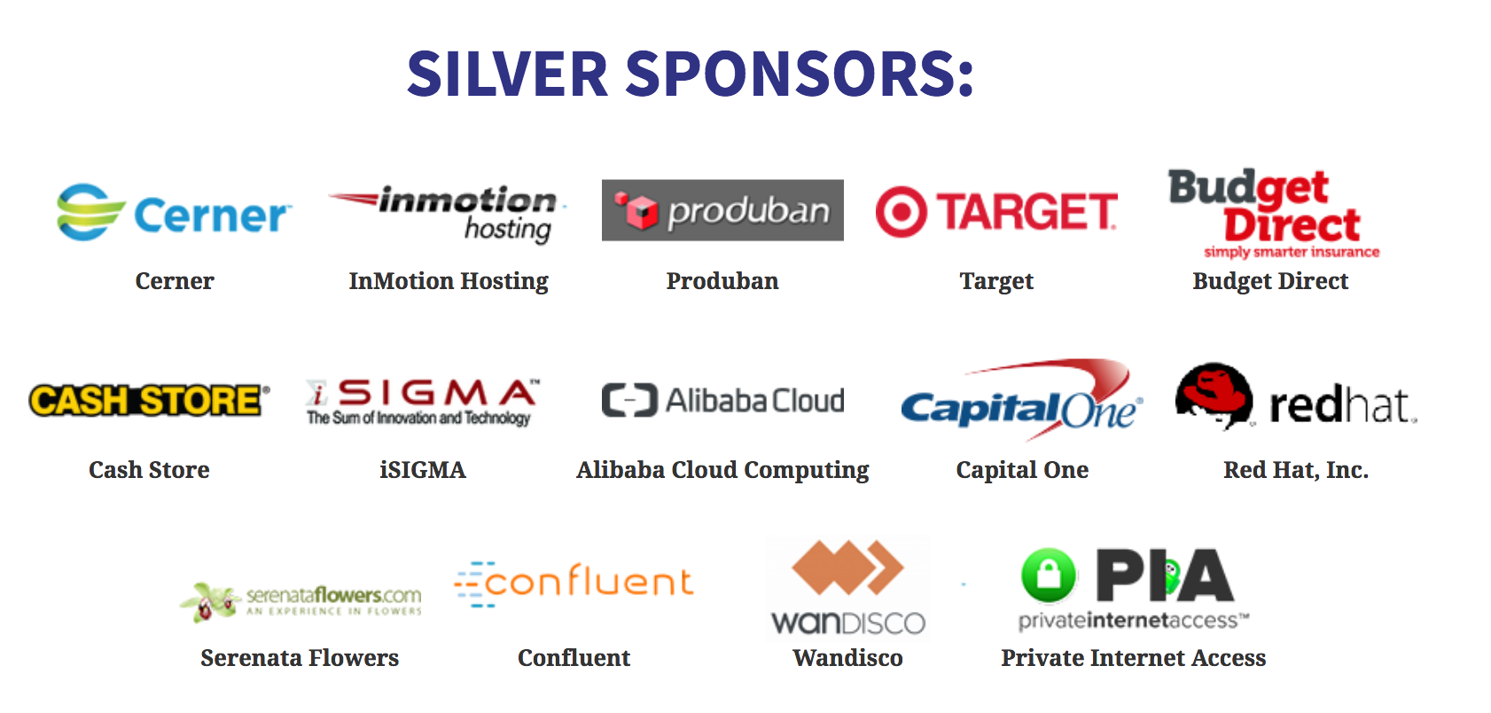

Slide 40
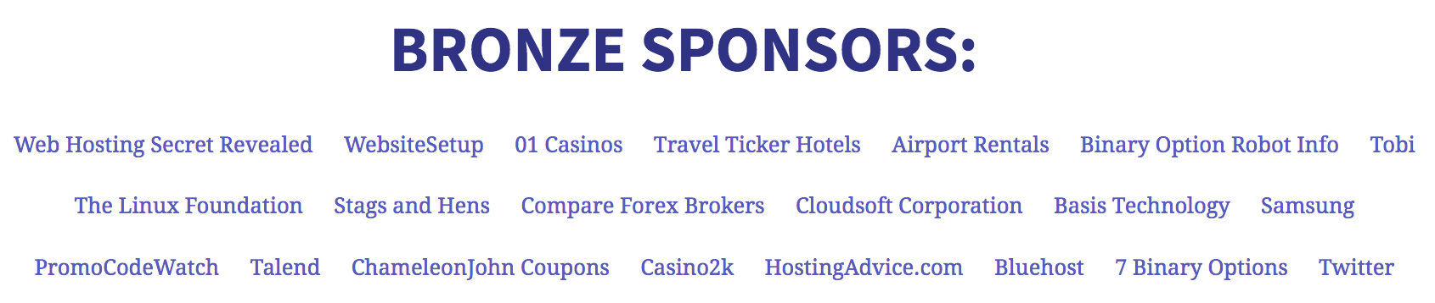

Slide 41
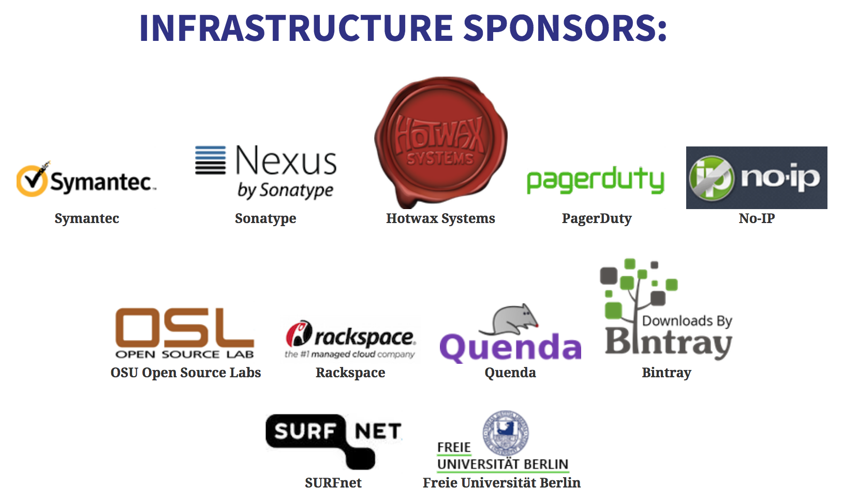

Slide 42
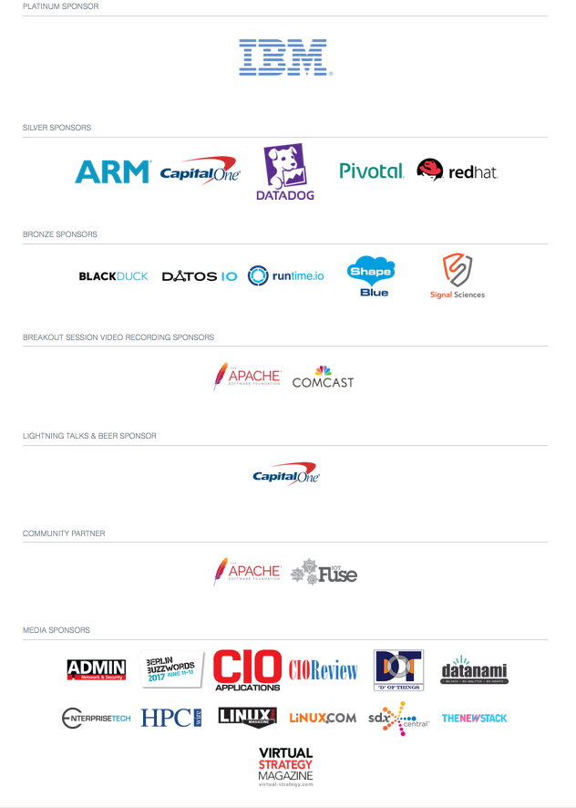
A special thank you to our ApacheCon and Apache: Big Data sponsors!

Slide 44
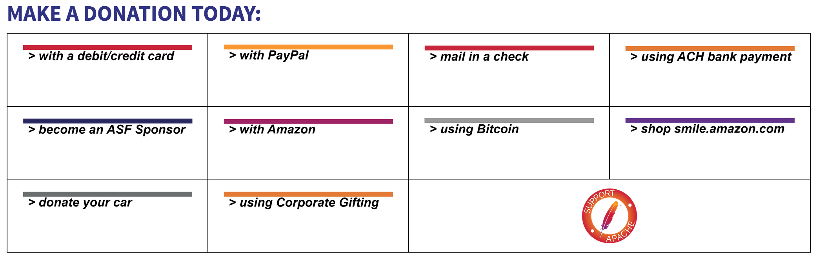

Slide 45



