Slide 1
State of the Feather
Sam Ruby, ASF President
9/10/2019 - 9102/01/9
Las Vegas

Slide 2
Welcome to ApacheCon NA
Has it really been twenty years already?

Slide 3

Phones were different then
This Photo by Unknown Author is licensed under CC BY-SA

Slide 4
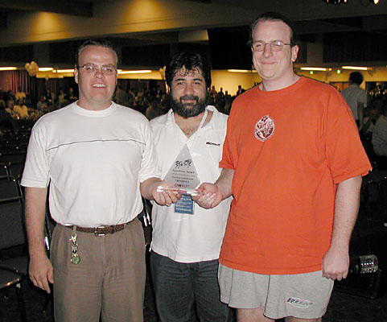
We were a bit different then

Slide 5
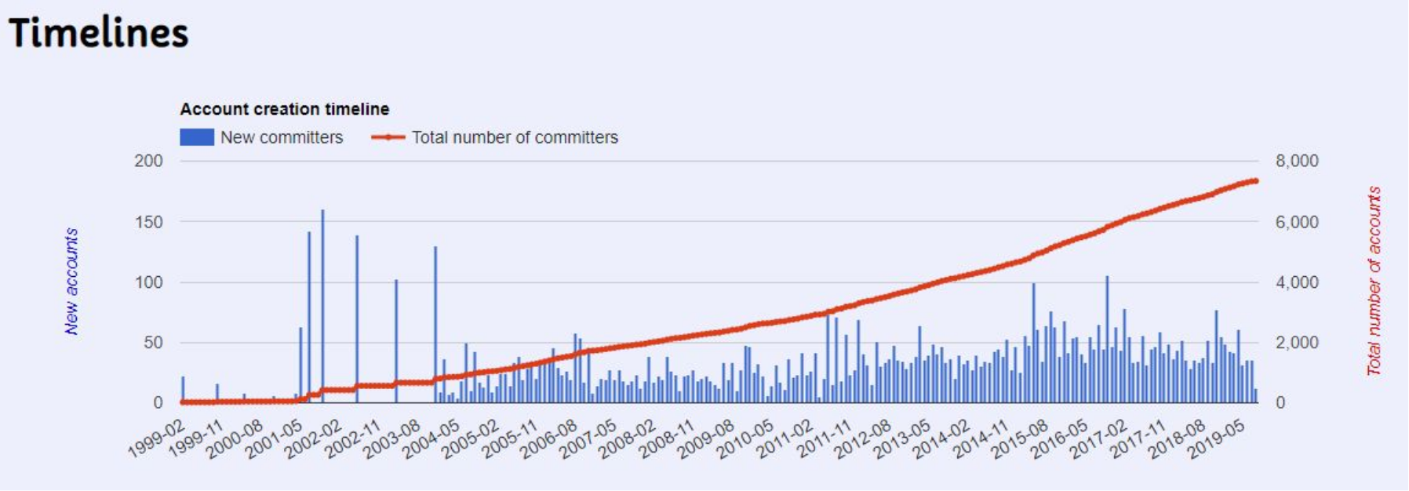
We’ve grown a bit since then

Slide 6
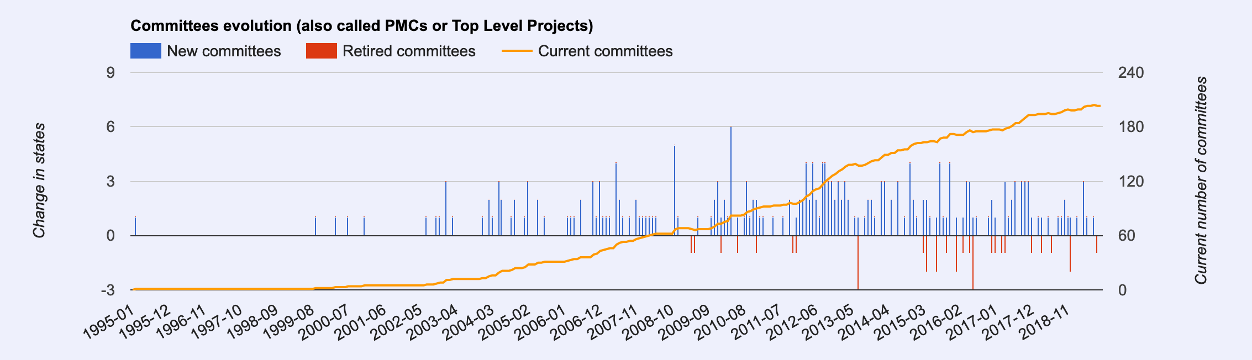
We’ve grown a bit since then

Slide 7
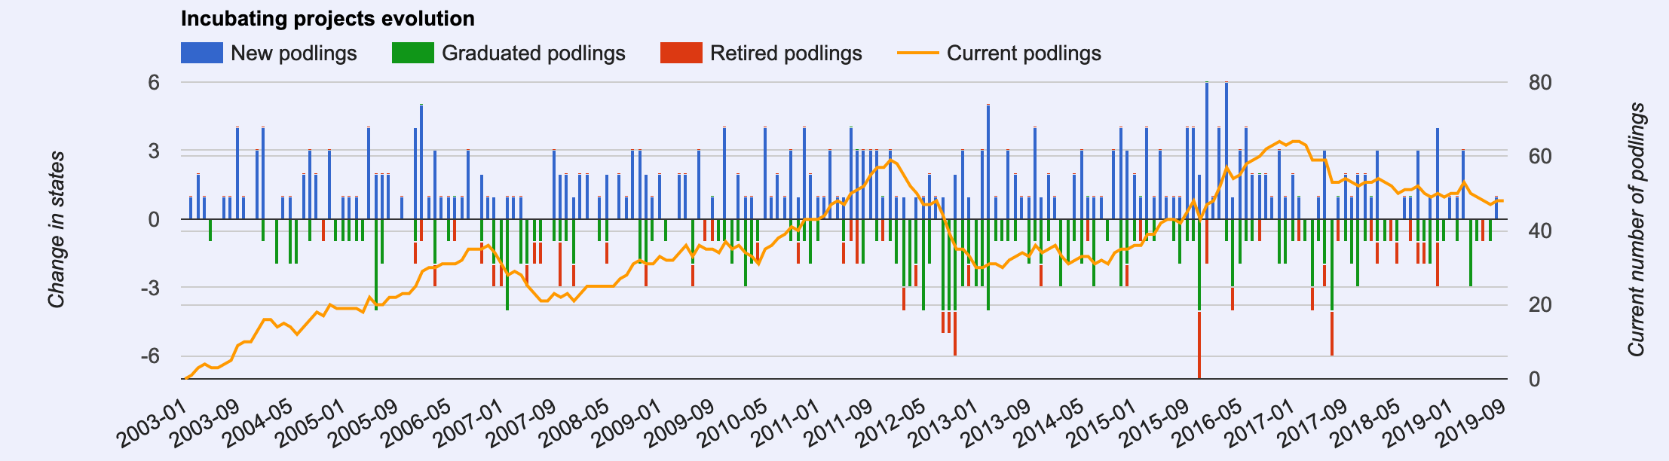
We have a strong pipeline

Slide 8
New projects
  OpenWhisk
  Dubbo
  PLC4X
  SkyWalking
  NetBeans
  Unomi
  Griffin

Slide 9
Statistics
7,036 Committers
765 Members
203 Committees managing 334 Projects
48 Incubating Podlings

Slide 10
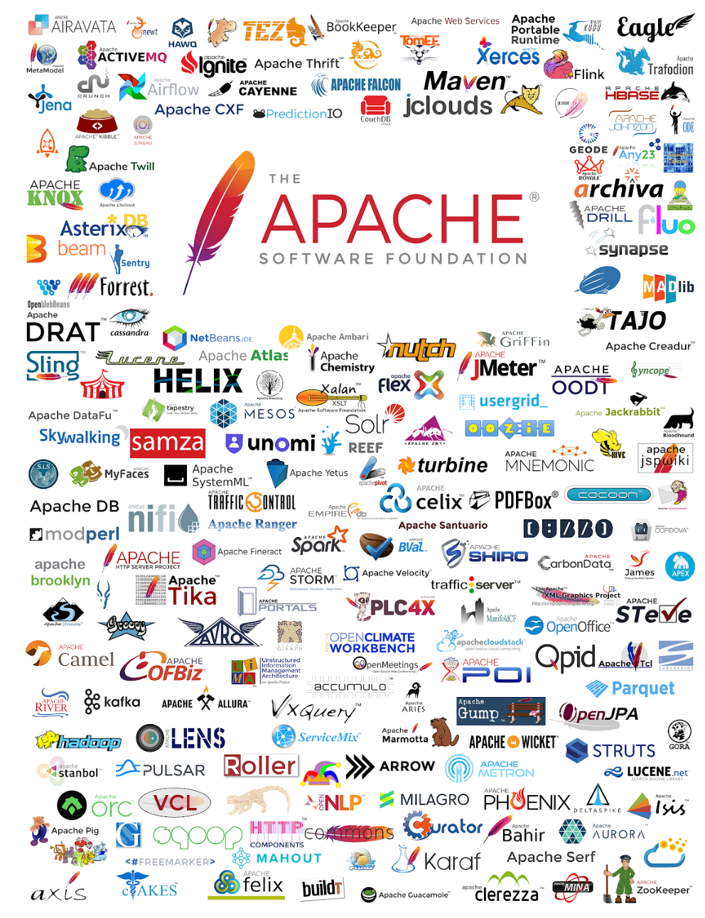

Slide 11
Overall status
Apache Software Foundation continues to evolve, innovate, and lead by example — a testament to our principles that have brought us through the first 20 years. The impact of Apache project communities on the world has never been greater, and validates our well established and flourishing bottom-up, community-centric Open Source process.

Slide 12
What we mean by bottom-up
9 Directors are elected by the membership
  The board does NOT set technical directions for projects
  Approves new projects; oversees all projects and operations
  No Director has any more ability to set policy than any other Director
Members are nominated and elected by the membership
  All ASF member votes have equal weight.
PMC members and Committers are nominated and elected by projects
  No one PMC member has any more say than any other PMC member as to when a release is made.

Slide 13
Organizational Structure

Slide 14
Fundraising
Now employing a model of paid support to augment volunteers
Established a Sponsor Ambassador program
Formal Targeted Sponsorship program
Event support

Slide 15
Infrastructure
Automation of commonly requested work items: https://selfserve.apache.org/
“GitBox” service allows us to completely automate, authenticate, monitor, and mirror nearly 1,800 GitHub repositories.
Evaluating CDN offerings to improve world-wide access

Slide 16
Community Development
Held multiple roadshows
Participated in external conferences
Developed new contributor onboarding material
Begun to explore how to recognize non-technical contributions
GSoC – 14th consecutive year

Slide 17
Conferences
Past year:
  ApacheCon North America 2018, Montréal
  Apache Roadshow Berlin
  Apache Roadshow DC
  Apache Roadshow Chicago
Upcoming:
  ApacheCon Europe, in Berlin

Slide 18
Travel Assistance
13 applicants were accepted for ApacheCon NA
17 applicants have been accepted for ApacheCon EU

Slide 19
Marketing and Publicity
26 Press Releases
96 Informal Announcements
480 Tweets
53.3K Twitter followers
157 LinkedIn posts
629.9K LinkedIn impressions
59 Media Queries
24,220 Media Clips on ASF
37,837 Media Clips on Apache projects and ApacheCon
15 Analyst Briefings and Queries
345 Analyst Reports
52 Apache News Round-Ups
3 Quarterly Reports/Operations Summaries
FY 2018 Annual Report

Slide 20
Marketing and Publicity
20th Anniversary of The Apache Software Foundation
The Apache Way to Sustainable Open Source Success
Apache in 2018: By The Digits
"Success at Apache"
ASF Sponsor profiles: Bloomberg Leaseweb
Giving Tuesday: Individual Giving campaign
Project Perspectives: Apache RocketMQ and The Apache Way
Launch of Central Services to expand support for creative and outreach projects
Planning redesign of apachecon.com

Slide 21
Trademarks and Branding
Processes requests to use Apache marks for events, merchandise and publications
Legal support for Registration, Renewal, Assignment, and Infringement
Notable this year: a number of organizations that created new software licenses based on the Apache License, Version 2.0. We worked with them to ensure that their licenses were correctly named.

Slide 22
Legal Affairs
Sponsor put on US restricted entity list
Export compliance procedures
Incubator release policy
DMCA registration
General license questions
Formal line of communication to our pro-bono counsel
Interfacing with legal counterparts in other foundations
Policies for modified licenses
Reviewing contracts

Slide 23
Treasurer and Finance
  Five year plan
  Budget
    Monthly we review budget vs actual
    We are consistently under budget in terms of expenses, and consistently exceed our budget in terms of donations.
  Last year we passed our first ever audit
    ”unqualified”
  990’s and other financial records
  Board minutes, categorized

Slide 24
Diversity and Inclusion
Survey Design
Contributor Experience Research
Outreachy

Slide 25
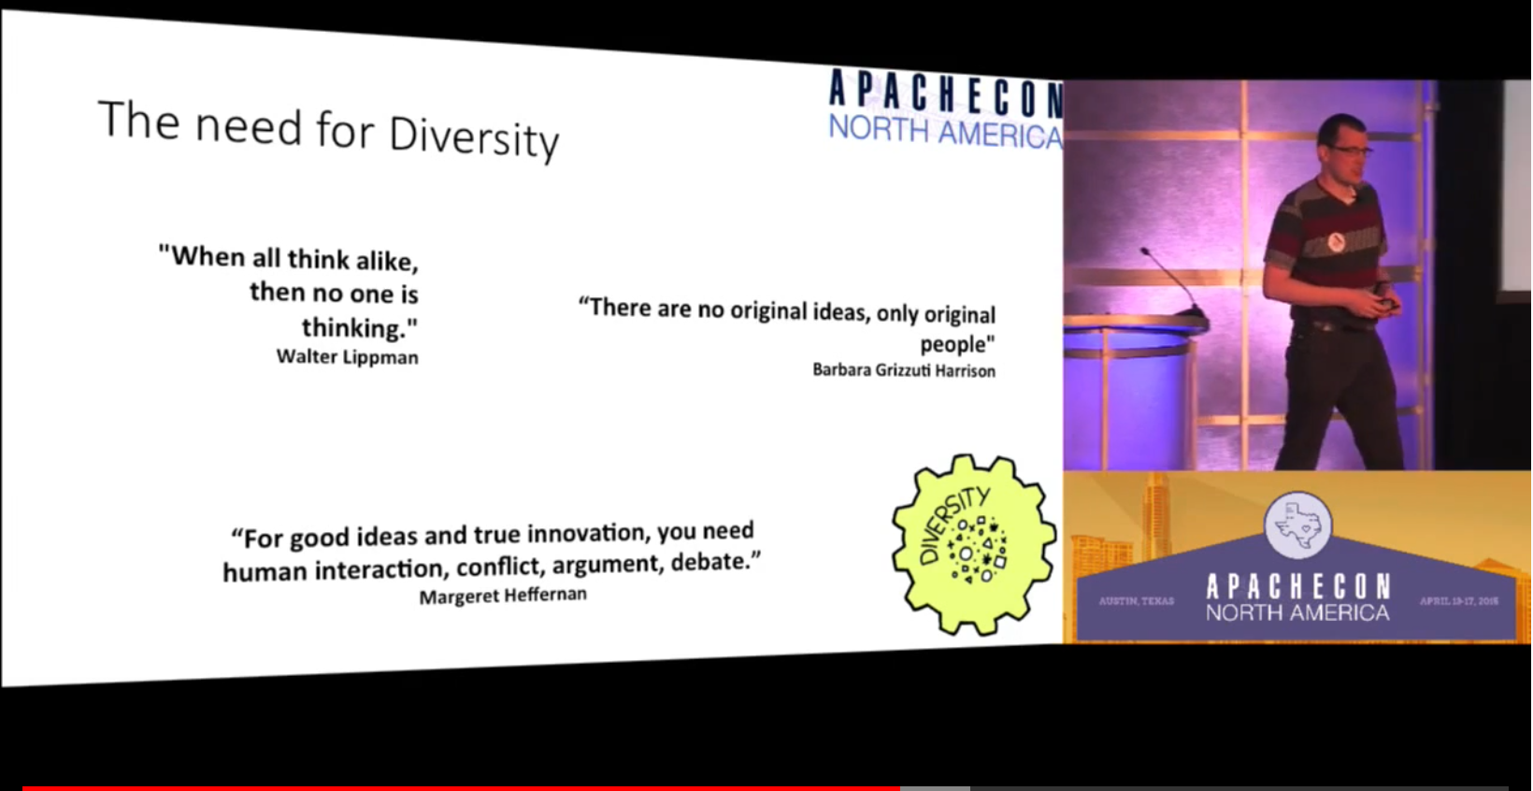

Slide 26
Worth Watching
Ross Gardler’s 2015 State of the Feather (starting at 18:40)
Gris Cueva’s The State of Diversity in Open Source & the ASF, Wednesday, 11th Sep, 11:00 - 11:50

Slide 27
Conference Sponsors

Slide 28


Slide 29
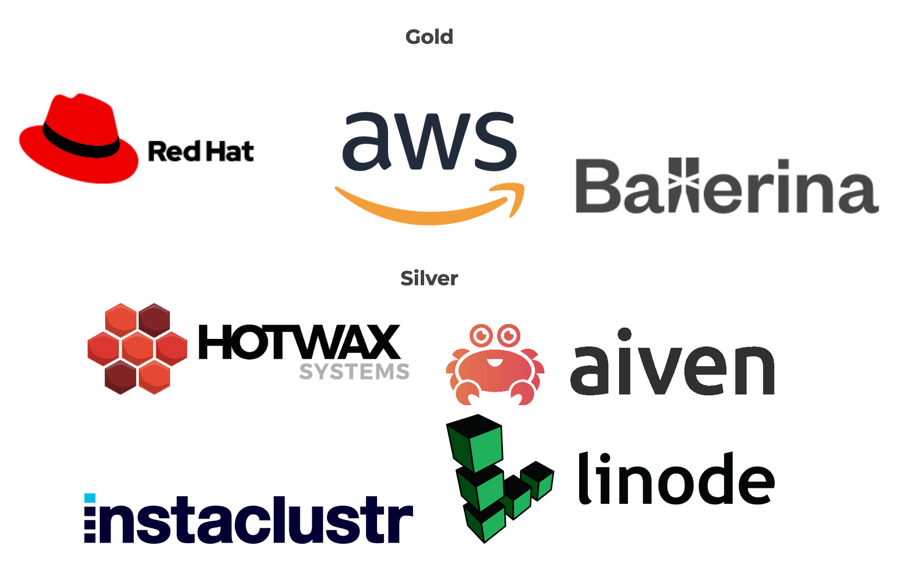

Slide 30


Slide 31


Slide 32
Sponsors

Slide 33


Slide 34


Slide 35


Slide 36


Slide 37


Slide 38


Slide 39
More Information

Slide 40
Places to explore
Home Page
Annual report
Sponsorship and thanks
Projects.apache.org
@TheASF

Slide 41
Community Links
Overview
Conferences
Summer of Code
Getting Started
The Apache Way
Travel Assistance
Get Involved
Code of Conduct
Community FAQ
Memorials

Slide 42
Innovation
Incubator
Labs
Licensing
Licensing FAQ
Trademark Policy
Contacts

Slide 43
Tech Operations
Developer Information
Infrastructure
Security
Status
Contacts

Slide 44
Press
Overview
ASF News
Announcements
Twitter Feed
Contacts

Slide 45
Legal
Legal Affairs
DMCA
Licensing
Trademark Policy
Public Records
Privacy Policy
Export Information
Licensing FAQ
Contacts

Slide 46
Thank You!
@samruby
@TheASF
https://s.apache.org/ACNA-2019-SotF

